Slide 2
Nano Server: A Cloud Optimized Windows Server for Developers
2-755
Andrew Mason
Principal PM Manager
Jeffrey Snover
Distinguished Engineer

Slide 3
Agenda
What we hear from customers
Our Journey
Nano Server
Preliminary Results
Status and Roadmap
Call to Action/Go Dos

Slide 4
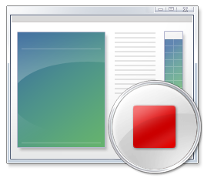
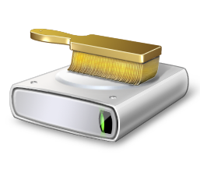

Voice of the Customer
Reboots impact my business
Why do I have to reboot because of a patch to a component I never use?
When a reboot is required, the systems need to be back in service ASAP
Server images are too big
Large images take a long time to install and configure
Transferring images consumes too much network bandwidth
Storing images requires too much disk space
Infrastructure requires too many resources
If the OS consumes fewer resources, I can increase my VM density
Higher VM density lowers my costs and increases my efficiency & margins

Slide 5
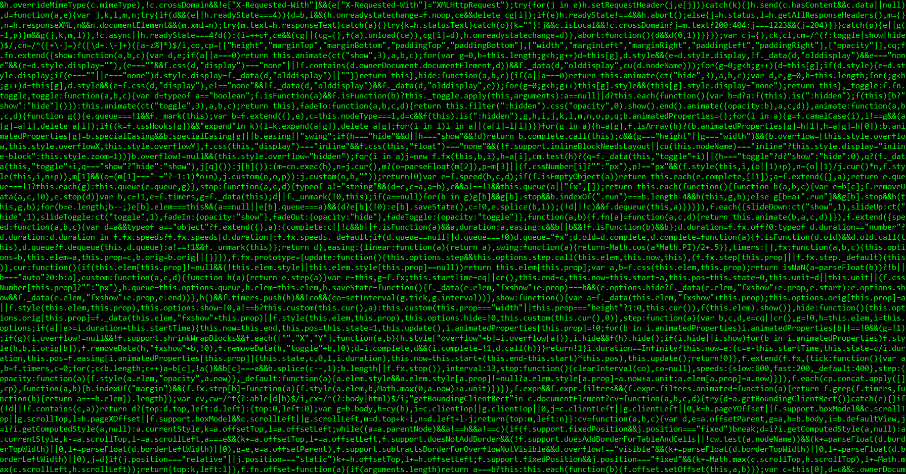


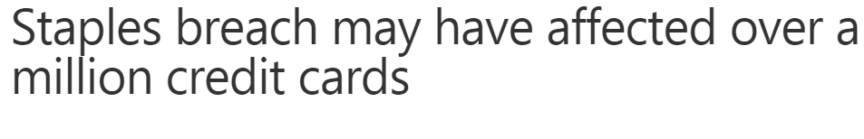
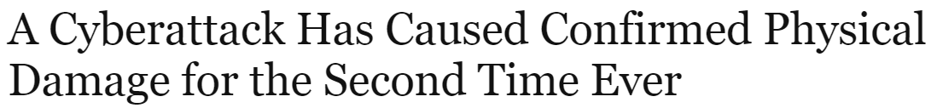
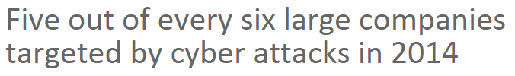
Security Impact

Slide 6
I want just the components I need and nothing more

Slide 7
Our Server Journey*
* Admin GUIs on servers are poison

Slide 8
Our Cloud Journey
Azure
Patches and reboots interrupt service delivery
(*VERY large # of servers) * (large OS resource consumption) => COGS
Provisioning large host images competes for network resources
Cloud Platform System (CPS)
Cloud-in-box running on 1-4 racks using System Center & Windows Server
Setup time needs to be shortened
Patches and reboots result in service disruption
Fully loaded CPS would live migrate > 16TB for every host OS patch
Network capacity could have otherwise gone to business uses
Reboots: Compute host ~2 minutes / Storage host ~5 minutes

Slide 9
We need server configuration optimized for the cloud

Slide 10
Nano Server - Next Step in Our Cloud Journey
A new headless, 64-bit only, deployment option for Windows Server
Deep refactoring focused on
CloudOS infrastructure
Born-in-the-cloud applications
Follow the Server Core pattern

Slide 11
Nano Server - Roles & Features
Zero-footprint model
Server Roles and Optional Features live outside of Nano Server
Standalone packages that install like applications
Key Roles & Features
Hyper-V, Storage (SoFS), and Clustering
Core CLR, ASP.NET 5 & PaaS
Full Windows Server driver support
Antimalware Built-in
System Center and Apps Insight agents to follow

Slide 12
Nano Server - Management
Eliminating the need to ever sit in front of a server
Configuration via PowerShell Desired State Configuration (DSC)
Remote management/automation via Core PowerShell and WMI
Integrate into DevOps toolchains

Slide 13
Visual Studio Release Management

Slide 14
Nano Server - Core PowerShell
Refactored to run on CoreCLR
Full PowerShell language compatibility & remoting
Invoke-Command, New-PSSession, Enter-PSSession, etc.
Most core engine components
Support for all cmdlet types: C#, Script, and CIM
Limited set of cmdlets initially

Slide 15
Remote Server Management Tools
Web-based
Includes replacements for local-only tools
Task Manager
Registry Editor
Event Viewer
Device Manager
Sconfig ----------------------------
Control Panel
File Explorer
Performance Monitor
Disk Management
Users/Groups Manager
Also manages Server Core and Server with GUI

Slide 16
Nano Server - Cloud Application platform
Born-in-the-cloud application support
Subset of Win32
CoreCLR, PaaS, and ASP.NET 5
Available everywhere
Host OS for physical hardware
Guest OS in a VM
Windows Server containers
Hyper-V containers
Future additions
PowerShell Desired State Configuration (DSC) & PackageManagement
Additional Roles and Application Frameworks

Slide 17
Server Application Development
Deep refactoring
Client stack for RDS
Developers target Server or Nano Server
Deploy to Physical, Virtual or Containers
Remote Desktop Server
Local Admin Tools
Client
(aka Server w/a GUI)
(Aka Full Server)
Physical, Virtual, Containers
Server
Nano Server

Slide 18
ASP.NET 5 Music Store on Nano Server

Slide 19
Nano Server - Developer Experience
Windows SDK & Visual Studio 2015 target Nano Server
Download tooling from the VS gallery
Rich design-time experience
Project template, full IntelliSense, error squiggles, etc.
Full remote debugging experience

Slide 20
Nano Server Developer Experience

Slide 21
Reverse Forwarders
A missing DLL will result in your code failing to run
Provide a way to run existing code without recompiling code for Nano Server
With Reverse Forwarders your code will load and API calls in those DLLs will either result in
API call will succeeding if the API is in the Nano Server boundary
Return of Not Implemented if it is not within the Nano Server boundary
Does not eliminate the need to refactor code to what is available in Nano Server

Slide 22
Reverse Forwarders (cont.)
Optional package that can be included in a Nano Server image when needed
Available reverse forwarders include:
advapi32.dll
comctl32.dll
comdlg32.dll
gdi32.dll
kernel32.dll
ole32.dll
psapi.dll
shell32.dll
shlwapi.dll
user32.dll
version.dll
winmm.dll

Slide 23
What runs today with the Reverse Forwarders?
Chef
PHP
Nginx
Python 3.5
Node.js
GO
Redis
MySQL
OpenSSL
Java (OpenJDK)
Ruby (2.1.5)
SQLite

Slide 24
DevOps with Nano Server using Chef

Slide 25
Installing Software on Nano Server
No MSI support in Nano Server
Current builds of Nano Server require xcopy or custom PowerShell script
Nano Server Installer in the works, which will provide
Install
Uninstall
Inventory
Online and offline installation support

Slide 26
Nano Server Installer Supported Tasks
Files​
Create and Delete folders
Copy and Delete files
ACLs for files and folders​
Services ​
Configure, Start​, and Delete​
COM ​
Register and Deregister COM class​es
Registry
Create and Delete Registry entries​
ETW events (note that this is a custom action in MSI)​

Slide 27
Preliminary Results

Slide 28
Servicing Improvements*
23
26
11
23
6
9
8
3
2
* Analysis based on all patches released in 2014

Slide 29
Security Improvements
46
31
98
73
22
12

Slide 30
Resource Utilization Improvements
26
255
139
21
150
61

Slide 31
Deployment Improvements
300
6.3
4.84
40
.4
.41

Slide 32
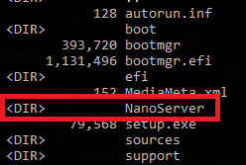
Nano Server in Windows Server vNext
Will be an installation option, like Server Core
Not listed in Setup because image must be customized with drivers
Separate folder on the Windows Server media
Available in the next Server build being released early May

Slide 33
Roadmap
Nano Server is the future nucleus of Windows Server
Target for cloud components and Born-in-the-Cloud applications
New foundation for all components
Provides a Just Enough OS model for all applications
Not everything will run on Nano Server
Server Core provides compatibility for existing Enterprise applications
Physical, Virtual, Containers
Existing Enterprise Applications
Born-in-the-Cloud
applications
Server Core
Nano Server

Slide 34
Call to Action/Go Dos
Retarget your code to Nano Server
Deploy Nano Server and your code and let us know where you encounter difficulties: nanoserver@microsoft.com
Shift your org and tools to full remote management of Server Core
Inventory tools and agents that only run locally
Check with your ISV for a remotable version
Send list of those with no remote equivalent and ISV to nanoserver@microsoft.com

Slide 35
Resources
Improve your skills by enrolling in our free cloud development courses at the Microsoft Virtual Academy.
Try Microsoft Azure for free and deploy your first cloud solution in under 5 minutes!
Easily build web and mobile apps for any platform with AzureAppService for free.

Slide 36
Core PowerShell

